Slide 1
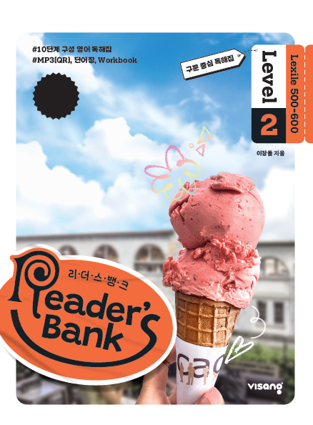
수업용
본문 PPT 자료
Reader’s Bank Level 2
Unit 08

Slide 2
22 AI로 증명사진 만들기 / p.56
Reader’s Bank_Level 2
Do you need a new ID photo? Just give one of your pictures to AI. AI will look at it and make a nice ID photo for you quickly. ⓐAI can change your clothes. ⓑIt can also make you smile. ⓒYou may not like some parts of the background. ⓓAI can change or even erase them, too. ⓔAI pictures are popular with children. Now your photo is ready! Just download it. It is quick and simple.

Slide 3
23 파란색의 다양한 의미 / p.57
Reader’s Bank_Level 2
Long ago, people believed the blue sky was the home of the gods. So blue made them feel happy. In the West, many people still think that blue brings good luck. Some athletes wear blue to win. In China, however, blue can mean a new start or death. So people sometimes wear blue at funerals. Blue is a cool color. It can mean many things around the world.

Slide 4
24 새 친구를 사귀려면 눈을 맞추세요 / p.58
Reader’s Bank_Level 2
You are at a party. There are many boys and girls around you. This is a good chance to make new friends. How do you start? Use eye contact. ( ⓐ ) If people look at you often, they may be interested in you. ( ⓑ ) If you like them, look back at them. ( ⓒ ) This can make them feel uncomfortable. ( ⓓ ) Do you want to make your eye contact more friendly? ( ⓔ ) Then just smile when you look at people. This will help them approach you more easily.
But don’t look at them for too long.

