Slide 1
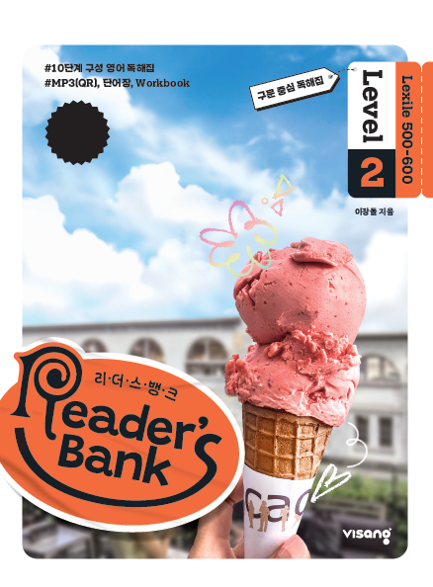
수업용
본문 PPT 자료
Reader’s Bank Level 2
Unit 07

Slide 2
19 한국에도 열대 과일이 자란다 / p.50
Reader’s Bank_Level 2
Mangoes and papayas are tropical fruits. They come from the hot countries of Southeast Asia. But now Korean farmers can grow them. How is this possible? Is Korea warm enough? Yes, it is. And here is the reason. The Earth is getting hotter. This makes the Korean climate hotter, too. Now, some tropical fruits can grow well in Korea.

Slide 3
20 내 기도가 할아버지에게 닿기를! / p.51
Reader’s Bank_Level 2
John loved chocolate. But his mom worried about his teeth. Sometimes Grandpa gave him chocolate. John’s mom didn’t say anything to make Grandpa happy.
John’s birthday was coming soon. In his room, John prayed loudly, “God, please give me chocolate for my birthday!”
His mom asked, “Why are you shouting, John? God can hear well.”
John said, “I know, but Grandpa in the next room can’t hear very well.”

Slide 4
21 생태계의 순환 / p.52
Reader’s Bank_Level 2
A mouse is eating corn. Suddenly a hungry snake comes along. Yum! The snake loves eating mice and swallows him quickly. But the snake doesn’t realize that an eagle is watching him from the sky. The eagle likes eating snakes. She flies toward the snake and eats him.
The eagle poops on the ground. The poop keeps the ground good and healthy. New corn grows from the good soil. Now we are back to the start of the food chain with new corn. Soon, another mouse will come along, and then a snake, and then an eagle. This cycle of life will go on forever.

