Slide 1
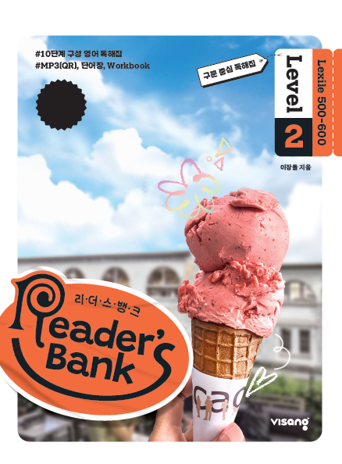
수업용
본문 PPT 자료
Reader’s Bank Level 2
Unit 06

Slide 2
16 축구 선수 등번호의 숨겨진 의미 / p.44
Reader’s Bank_Level 2
In sports, players wear numbers on their uniforms. Their teams give them numbers. The numbers show _________________. For example, goalkeepers wear number 1. Defenders wear numbers 2 to 6. What about forwards? They wear numbers 7 to 11. The number 10 is special. The best players such as Messi and Neymar wear that number.

Slide 3
17 저기, 자리 좀 양보해 주세요! / p.45
Reader’s Bank_Level 2
A blind man and his dog got on a subway. The subway was crowded with passengers. The dog looked for a seat for the blind man. The dog went to a young man and looked at him, but he didn’t stand up. The dog moved to a little girl and looked at her. The girl saw the blind man and the dog and smiled warmly. She gave the man her seat.

Slide 4
18 폭탄을 탐지하는 꿀벌들 / p.46
Reader’s Bank_Level 2
Did you know bees can find bombs? It’s true! Bees are very good at smelling. They use their strong sense of smell to find bombs. How do people train the bees? They give the bees yummy food when the bees smell a bomb. After doing this exercise a few times, the bees learn they will get a treat ________
___________________. When the bees smell a bomb, they stick out their tongues because they expect food. These special bees are called “sniffer bees.” Isn’t that cool? These little helpers can keep us safe!

