Slide 1
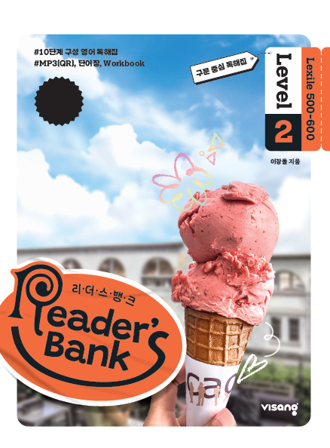
수업용
본문 PPT 자료
Reader’s Bank Level 2
Unit 05

Slide 2
13 엄마 침팬지의 사랑 / p.38
Reader’s Bank_Level 2
In a zoo in Spain, there is a mother chimpanzee. Her name is Natalia. She had a baby, but the baby died two weeks later. Surprisingly, Natalia still shows it love and care. She carries her baby everywhere. She also touches and kisses it. People at the zoo understand her feelings. They feel as sad as Natalia.

Slide 3
14 꽃과 인간의 공통점 / p.39
Reader’s Bank_Level 2
A white flower says to a yellow flower, “I am more beautiful than you.” Is the white flower right? No. A yellow flower is as beautiful as a white flower. The color doesn’t make a difference. Flowers of all colors are equally beautiful. In the same way, people of all colors are equally beautiful. They are all lovely children of Mother Nature.

Slide 4
15 화성에 박테리아 보내기 / p.40
Reader’s Bank_Level 2
Long ago, Earth was empty. There was no oxygen. And it was as hot as a stove. No life could live on it. Then, something special happened. Tiny bacteria appeared and changed the Earth completely. The bacteria made oxygen by using sunlight. As a result, the Earth became a good place to live. Plants and animals started to show up. Mars is like the young Earth in some ways. It has no air and no life. If we send bacteria to Mars, they may change the planet. If that happens, Mars will be as comfortable as the Earth. It will become a new home for humans.

