Slide 1
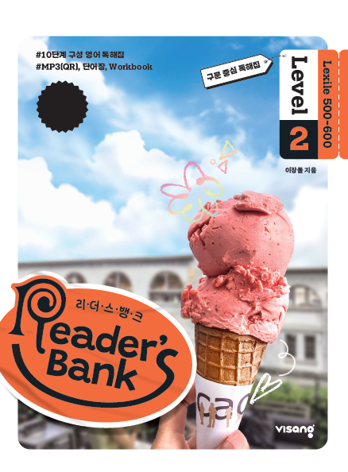
수업용
본문 PPT 자료
Reader’s Bank Level 2
Unit 03

Slide 2
07 파자마 파티 / p.26
Reader’s Bank_Level 2
Sarah loves having slumber parties. She often invites her friends to sleep over at her house. This is a good way to spend time with her friends. They do a lot of fun things. They fight with their pillows. They sing songs and watch scary movies. They also eat delicious ice cream and tell funny stories. After all these activities, they lie in bed and fall asleep.

Slide 3
08 운동할 때는 이 과일을 챙기세요 / p.27
Reader’s Bank_Level 2
Tennis players like to eat bananas when they play matches. Why do they do so? Bananas have a lot of natural sugars. These sugars give them quick energy. Bananas also have plenty of minerals. These minerals help muscles work better. Bananas are easy to digest, too. How cool! They are the best snack to give quick energy.

Slide 4
09 놀라운 축구의 기술 / p.28
Reader’s Bank_Level 2
In soccer, players do cool tricks. Some players kick the ball between another player’s legs. Then, they get the ball again on the other side of the player. This is a smart way to avoid a defender. ( ⓐ ) Neymar and Eden Hazard do it often. ( ⓑ ) They step on the ball and pretend to push it back. ( ⓒ ) Then, they quickly roll it forward. ( ⓓ ) It surprises other players. ( ⓔ ) Do you know why? Those players think the ball will go backward. Messi and Ronaldo use this trick often. They change the game with it. Soccer is full of fun surprises. These tricks make the game exciting.
Other players use a different trick.

