Slide 1
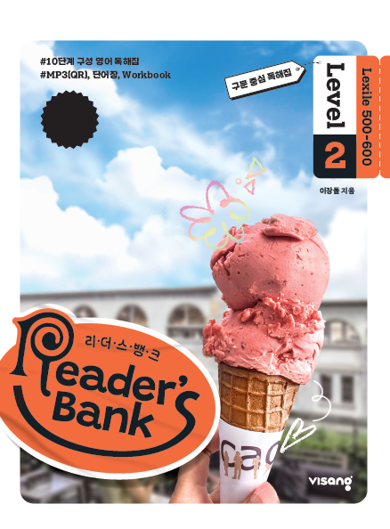
수업용
본문 PPT 자료
Reader’s Bank Level 2
Unit 02

Slide 2
04 변신의 왕은 바로 나! / p.20
Reader’s Bank_Level 2
There is a very interesting plant. This plant can imitate things around it. It changes its color to look like other plants. It also changes its leaf shape to hide from animals. The name of this amazing plant is Boquila. It comes from Argentina and Chile. Its skills help it survive. Truly, it is a plant chameleon!

Slide 3
05 용돈을 올려 받은 비결 / p.21
Reader’s Bank_Level 2
Laura got ten dollars a week from her parents. But she needed more money. She wanted to buy her favorite things. Laura asked her parents for a bigger allowance. But they said no. ( ⓐ ) Laura came up with an idea to change their minds. ( ⓑ ) She washed their cars every morning. ( ⓒ ) She also did the dishes. ( ⓓ ) Her parents decided to raise her allowance. ( ⓔ ) Now she is glad to get fifteen dollars a week.
Amazingly, this plan worked!

Slide 4
06 상상 그 이상의 게임 세상 / p.22
Reader’s Bank_Level 2
Computer games are changing every day. In the past, computer games were simple. They had fixed rules or stories. You could not change them at all. Today, things are different. Players can change different parts of the games. ⓐThey can change the rules to make them more fun. ⓑSome players don’t like this. ⓒIn Roblox, for example, you can become a superhero or anyone you like. ⓓIn addition, in Minecraft, you can build big cities. ⓔYou can also visit new worlds. In short, games today let you be anyone and go anywhere.

