Slide 1
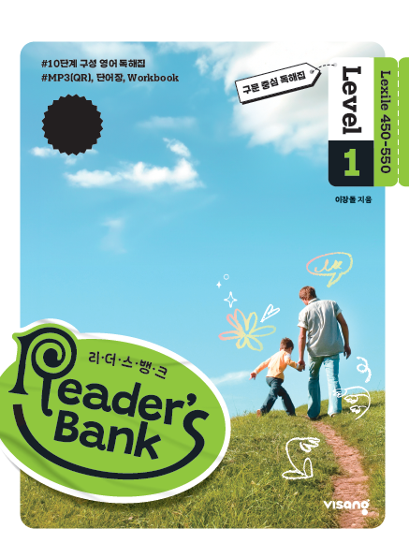
수업용
본문 PPT 자료
Reader’s Bank Level 1
Unit 10

Slide 2
28 나는 재주가 많은 동물이에요! / p.68
Reader’s Bank_Level 1
I have strong arms and legs, so I can climb trees very well. Jumping from tree to tree is easy for me. I also have a long tail. It helps me grab the tree branches. Fruits are my favorite snack. I eat bananas, mangoes, and papayas. I look like a human, but my body has soft fur all over. I love copying human actions. It’s not just my hobby. It’s my way of learning new things.

Slide 3
29 기억력을 높이는 방법 / p.69
Reader’s Bank_Level 1
Learning new things is very hard. Some scientists say we forget about 60% of them in one hour. After a day, we remember only about 30%. Do you want to remember more? Try this: Review right after learning. Review again 20 minutes later. Then, take a break. Review again the next day. This method keeps your memory strong. Why? It moves the information into your long-term memory.

Slide 4
30 긴 동영상은 지루해 / p.70
Reader’s Bank_Level 1
Watching short videos on YouTube is very popular now. Why? Today, people are so (A)[ busy / free ]. They don’t have time to watch long videos. One of their favorite types is dance videos. In these videos, kids dance to cool music. They pretend to sing and dance like stars. But they don’t actually sing. They just move their lips, but it looks (B)[ wrong / real ]. Another popular type of video is challenge videos. These are like games. There, kids do funny things, like eating strange food and racing. They try to finish before the time runs out. Who will win? (C)[ Making / Guessing ] the winner is fun. These videos are exciting and make us laugh.

