Slide 1
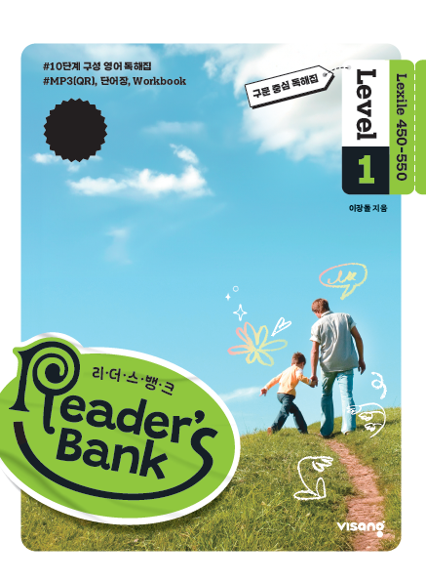
수업용
본문 PPT 자료
Reader’s Bank Level 1
Unit 08

Slide 2
22 난 언젠가 날 거야! / p.56
Reader’s Bank_Level 1
I live in a beautiful garden. I have a lot of legs and hair, so I may look scary. I crawl on green leaves and eat them. I sometimes eat flowers, too. I have a big dream. I dream that I have large, beautiful wings. With wings, I can fly high above colorful flowers in the garden. I hope that my dream will come true soon.

Slide 3
23 화장하는 아이들 / p.57
Reader’s Bank_Level 1
Today, many teenagers enjoy wearing makeup. Why? Because it makes them feel good. When they wear makeup, they can show off their good points. They can also hide their weak points. However, some people are _________. They think makeup is bad for teenagers’ young skin. They say, “Eat good food and exercise. This will make you beautiful inside and out. It is better than makeup.”

Slide 4
24 우리가 몰랐던 스타에 관한 진실 / p.58
Reader’s Bank_Level 1
Many kids want to become famous. They think that singers and actors are cool. Some kids believe that they make a lot of money. So from a young age, they dream of becoming one. ( ⓐ ) Becoming a star is very hard work. ( ⓑ ) First, you must have great talent. ( ⓒ ) You must also work really hard. ( ⓓ ) Sadly, only a few people succeed. ( ⓔ ) And many of them don’t make enough money. They often need another job. Being a star is never easy. Do you still dream about it?
However, they may not know the truth.

