Slide 1
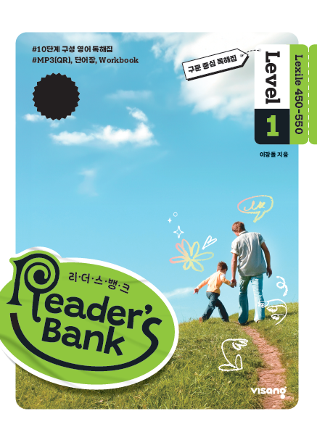
수업용
본문 PPT 자료
Reader’s Bank Level 1
Unit 06

Slide 2
16 너의 비밀은 내가 지켜 줄게! / p.44
Reader’s Bank_Level 1
You keep a diary on the computer in the living room. But your parents or sister can use that computer. They may read your diary. You are worried about it. What should you do? You should use me for your files! I am a secret word, like a magic key. If people don’t know me, they can’t open your files. I will keep them safe.

Slide 3
17 함께하는 것을 좋아하는 돌고래 / p.45
Reader’s Bank_Level 1
Dolphins hunt in groups. When they find a fish, they attack it together. Dolphins can’t chew their food. So they must swallow it quickly. If they don’t, the fish will swim away. Dolphins also like to play together. They jump out of the water and do tricks in the air. They often chase each other for fun.

Slide 4
18 검은 고양이에 관한 미신 / p.46
Reader’s Bank_Level 1
You are walking down the street. Suddenly, a black cat quickly passes by. Is that good or bad? In Scotland, some people think it is a good thing. They believe that seeing a black cat is lucky. They say you may get a lot of money or make a new friend. But in America, it is very different. Americans believe a black cat may bring bad luck. They say you may lose money or have problems. So they say you must be careful. Seeing a black cat means ________ things in ________ countries. Isn’t that interesting?

