Slide 1
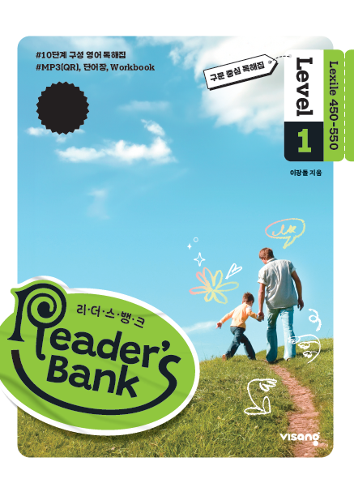
수업용
본문 PPT 자료
Reader’s Bank Level 1
Unit 05

Slide 2
13 재미난 곳엔 항상 내가 있죠! / p.38
Reader’s Bank_Level 1
At first, I’m just small and flat. Blow air or gas into me, and I become round and fat. I can also float into the sky. People celebrate parties and festivals with me. You can also find me at an amusement park. Children enjoy playing with me. But be careful! Don’t touch me with sharp things. I burst very easily. And when I burst, everyone is surprised!

Slide 3
14 신선한 달걀 고르는 법 / p.39
Reader’s Bank_Level 1
Can you choose fresh eggs? There is an easy way to do it. Fill a bowl with cold water and put an egg into it. A fresh egg is heavy, so it sinks to the bottom. A rotten egg has gases inside, so it comes to the top of the water. What about a 2-week-old egg? The egg doesn’t sink or float. Instead, it stays in the middle.

Slide 4
15 식당 음악에 숨겨진 비밀 / p.40
Reader’s Bank_Level 1
Restaurants usually play music. You may not know it, but the music is very important to people’s health. Do you know why? Music can make people pick certain food. Is the music fast and loud? Then people feel excited. And they often choose junk food. ( ⓐ ) They may choose fatty food or sugary food. ( ⓑ ) Is the music soft and slow? ( ⓒ ) Then people feel calm. ( ⓓ ) They may choose salads or fish. ( ⓔ ) It shows that music is important for good health. Do you want to be healthy? Then choose a _________ restaurant and enjoy _________ music.

