Slide 1
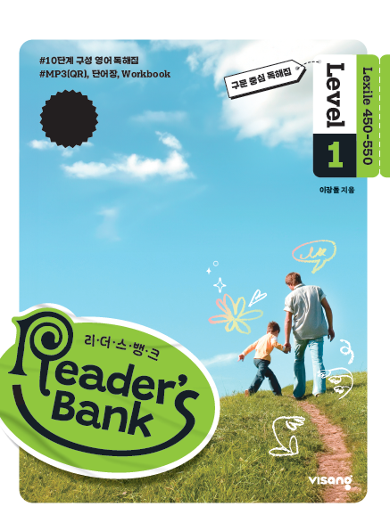
수업용
본문 PPT 자료
Reader’s Bank Level 1
Unit 03

Slide 2
07 나는 아름답지만 가시가 있어요! / p.26
Reader’s Bank_Level 1
I am very beautiful. I come in many colors, and some of my friends are red, pink, and white. People love me because I look pretty and smell nice. Do you have someone special in your life? I can be a nice gift for that person. Do you love someone? I can help you show it. But watch out! My thorns are sharp and they can hurt you.

Slide 3
08 신기한 붕대 / p.27
Reader’s Bank_Level 1
One day, you cut your finger, and it starts to bleed. What can you do? You can put a bandage on it. But wait a minute! There is a special bandage. This special bandage changes colors. It looks red on sick skin. But it looks blue when the skin gets better. How amazing! It can tell you about your skin’s health, just like a doctor.

Slide 4
09 두 떠돌이 개의 이야기 / p.28
Reader’s Bank_Level 1
Tuesday, November 12, 2024
On a street in the U.K., there were two stray dogs. One of the dogs, Glenn, was blind. But that was okay. The other dog, Buzz, was always with him. Buzz helped Glenn find food and a bed. Glenn also loved Buzz very much. Living on the street was not easy, but they felt happy together. People heard about their friendship. They felt sad for them. Some wanted to adopt Buzz. Others wanted to care for Glenn. However, Glenn and Buzz needed to stay together. Luckily, an animal center found a new home for them. Now, Glenn and Buzz live together in a safe, loving home.

