Slide 1
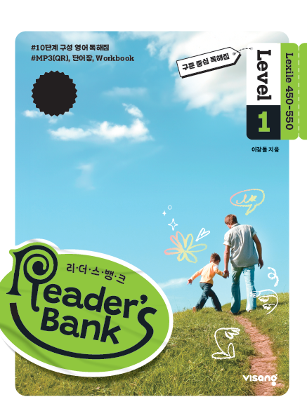
수업용
본문 PPT 자료
Reader’s Bank Level 1
Unit 02

Slide 2
04 나는 물고기가 아니에요! / p.20
Reader’s Bank_Level 1
I am a light and strong material. People make cups, bottles, and boxes from me. However, people throw me away after they use me. Then I flow into rivers and oceans. There, I look like food, so some fish eat me. This makes them sick. In fact, millions of fish die because of me. Poor fish! If you keep throwing me away, I will make all rivers and oceans ____________. No fish will live there.

Slide 3
05 젖소와 우유 / p.21
Reader’s Bank_Level 1
Helen raised some cows on a farm. She loved them very much. One day, she had an interesting idea. She thought, “I will sing for my cows. What will happen?” Helen began to sing to the cows every day. Soon, something wonderful happened. The cows started to give more milk! Helen was delighted and said, “I’m nice to my cows, and now the cows are nice to me!”

Slide 4
06 미래에는 어떻게 공부할까? / p.22
Reader’s Bank_Level 1
In the future, you will live in an amazing world. You won’t go to school. And you won’t learn from school teachers. But you will learn things quickly. How can you do that? In the future, you can put a tiny computer in your brain. The computer will do a great job. It can download new skills quickly. Do you want to learn the piano? You can download piano skills. Then you will be a pianist right away. Do you want to cook well? You can download cooking skills and become a ____________. Or do you dream of flying a plane? Then download flying skills and become a ____________. Just imagine that. Your future will truly be fantastic!

